Slide 1
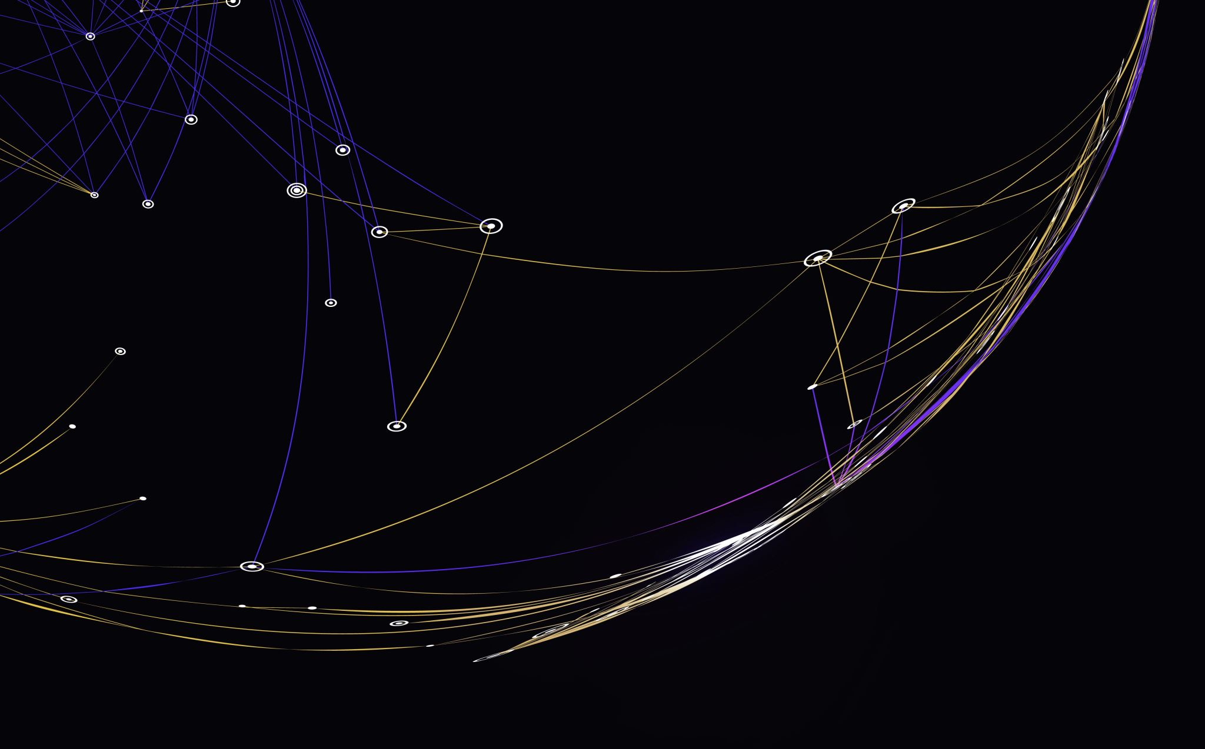
Objects and Data Structures
Clean Code – Chapter 6

Slide 2
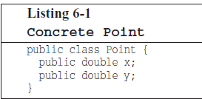
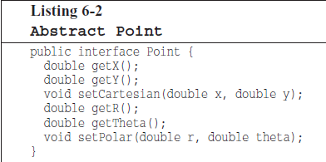
Data Abstraction
When you design code, you can either:
Expose implementation: show exactly how your data is stored internally.
Hide implementation: provide an abstract interface that hides the internal details.
Good abstraction isn’t just about adding getter/setter methods, it’s about thoughtfully designing interface that represent the essence of your data without revealing implementation details.

Slide 3
Data/Object Anti-Symmetry
Objects hide their data behind abstractions and expose functions that operate on that data.
Data structures expose their data and have no meaningful functions.
“Procedural code (code using data structures) makes it easy to add new functions without changing the existing data structures. OO code, on the other hand, makes it easy to add new classes without changing existing functions”.

Slide 4
Data/Object Anti-Symmetry (cont.)
“Procedural code makes it hard to add new data structurers because all the functions must change. OO code makes it hard to add new functions because all the classes must change.”
Things that are hard for OO are easy for procedures, and the things that are hard for procedures are easy for OO.
Mature programmers know that the idea that everything is an object is a myth. Sometimes you really do want simple data structures with procedures operating on them.

Slide 5
Data/Object Anti-Symmetry (cont.)
So, both approaches have their place:
Use objects/OO when you expect to add new data types frequently.
Use data structures/procedural when you expect to add new functions frequently.

